Slide 1
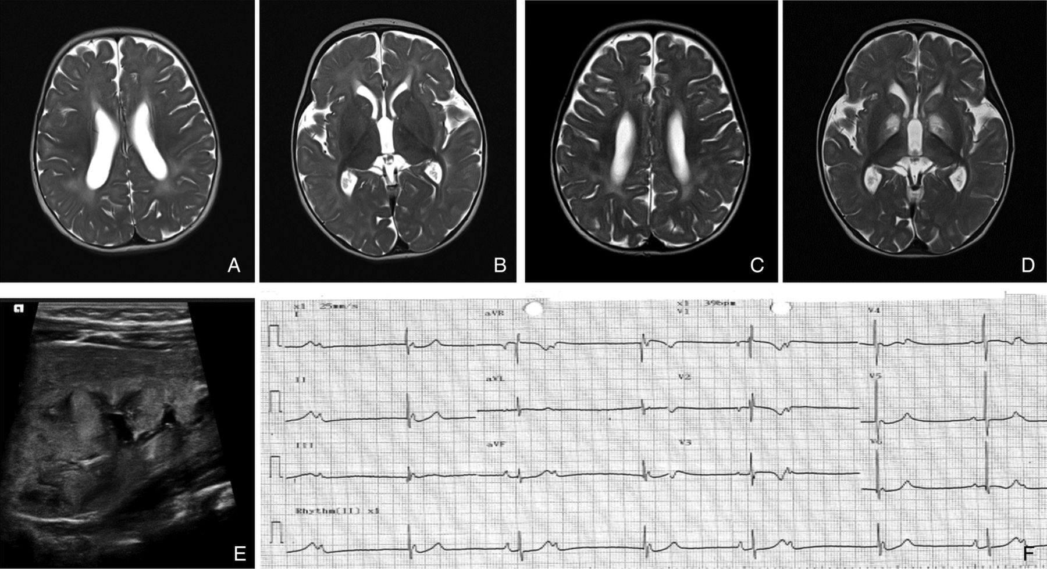

Radiological imaging.
Yi Shiau Ng et al. J Med Genet doi:10.1136/jmedgenet-2016-103910
©2016 by BMJ Publishing Group Ltd
Notes:
Radiological imaging. (A–D) Axial T2-weighted MRI head from P1. (A) There were prominent T2 hyperintensities in the white matter suggestive of delayed myelination and (B) basal ganglia appeared normal at 6 months. Repeat imaging (C) showed improvement of the white-matter abnormality but there were new, symmetrical changes in the basal ganglia (D) at 2 years old. (E) Renal ultrasound showed dysplastic kidney in P1. (F) Twelve-lead ECG of P10.2 showed atrioventricular (AV) dissociation and bradycardia (heart rate 39 bpm).

